Slide 1
Surface Realisation

Slide 2
Introduction
Surface realisation is representing documents and sentences in proper format.
Markup annotations and text specifications are used for surface realization.

Slide 3
Different aspects of text specifications
Structure realization : used for annotation and indent in text
Linguistic realization: used for phrases in sentences.

Slide 4
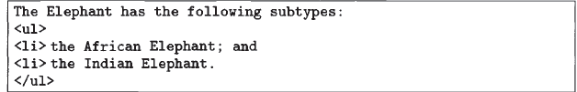
Example
Source :Reiter and Dale,Building Natural Language Generation Systems

Slide 5
Example
In example, African and Indian elephant are examples of linguistic realisation.
<li> and <ul> are examples of structure realisation.

Slide 6
Linguistic Realization
Syntactic realization : The order of words and their negation etc.
Morphological realization : plural of words
Orthographic realization : punctuations, e.g first letter of first word is capital.

Slide 7
Different levels of Surface realization
Skeletal Prepositions : basic content is covered.
E.g. The courier delivered the green bicycle to Mary.
Predicate logic : deliver(cl, p1,m)

Slide 8
Meaning Specifications
Source :Reiter and Dale,Building Natural Language Generation Systems

Slide 9
Canned Text and Orthographical Strings
Source :Reiter and Dale,Building Natural Language Generation Systems

